Slide 1
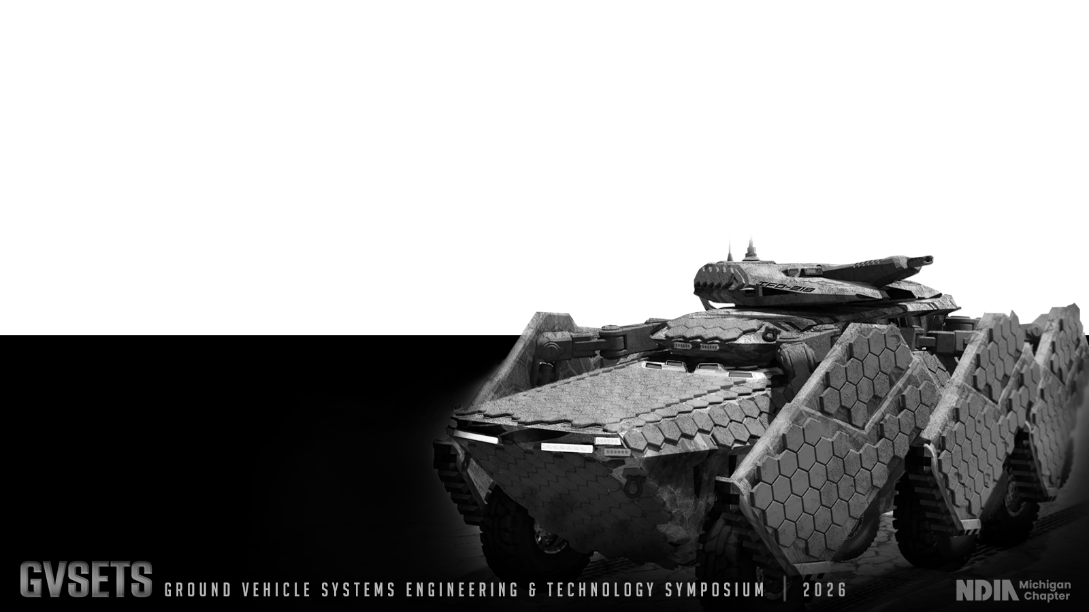
APPLIED ARTIFICIAL INTELLIGENCE
SHRIKE NANO
AI-Enabled sUAS Targeting for Digital Fires
CW2 Ali Baharanyi, Army AI2C | Greg Tozzi, Booz Allen Hamilton
GVSETS 2026 | Applied Artificial Intelligence | August 11–13, 2026 | Novi, Michigan
DISTRIBUTION STATEMENT A. Approved for public release; distribution is unlimited.
Notes:
Welcome the audience. Introduce Shrike Nano and the 3/101 field integration effort. Thank NDIA Michigan Chapter and GVSETS organizers.

Slide 2
Agenda
APPLIED ARTIFICIAL INTELLIGENCE
01
Problem & motivation
05
Field evaluation
02
Shrike Nano system overview
06
Performance results
03
Digital fires integration architecture
07
Lessons learned
04
AI-enabled targeting pipeline
08
Conclusions
GVSETS
GROUND VEHICLE SYSTEMS ENGINEERING & TECHNOLOGY SYMPOSIUM | 2026
NDIA Michigan Chapter
Notes:
Walk through the arc of the talk: problem, system, architecture, AI pipeline, field test with 3/101, results, lessons, conclusions.

Slide 3
The Targeting Gap
APPLIED ARTIFICIAL INTELLIGENCE
Traditional forward observer processes rely on manual target identification, voice communications, and disjointed systems, increasing cognitive load and delaying fire missions.
SHRIKE NANO CLOSES IT
Enables forward observers to detect, geolocate, and engage targets using sUAS video integrated within the Android Tactical Assault Kit (TAK) ecosystem, connected to AFATDS.
The proliferation of small unmanned aircraft systems (sUAS) at the tactical edge, creates a need to integrate aerial sensing directly into digital fires networks.
Supports "Find, Fix, Finish" across the targeting cycle.
GVSETS
GROUND VEHICLE SYSTEMS ENGINEERING & TECHNOLOGY SYMPOSIUM | 2026
NDIA Michigan Chapter
Notes:
Explain the gap: manual FO workflows are slow and disjointed; sUAS are proliferating at the tactical edge but not wired into digital fires.

Slide 4
System Overview
APPLIED ARTIFICIAL INTELLIGENCE
Shrike Nano is a body-worn, rapidly deployable targeting aid for forward observers and drone operators. Shrike Nano enables single-operator, sUAS-enabled digital fires workflows on a tactical smartphone.
sUAS Sensing
Edge Compute
TAK Interface
Fires Network
Real-time video & telemetry from small unmanned aircraft
On-device target detection and passive geolocation
Operator interface for target designation on the COP
Digital call-for-fire generation into AFATDS
Ingests video from platforms such as the Skydio X10D and PDW C100 via UAS Tool. The Shrike Nano ATAK plugin runs AI-assisted threat recognition on the feed.
GVSETS
GROUND VEHICLE SYSTEMS ENGINEERING & TECHNOLOGY SYMPOSIUM | 2026
NDIA Michigan Chapter
Notes:
Describe Shrike Nano as a portable, single-operator targeting aid that runs on existing FO hardware inside TAK.

Slide 5
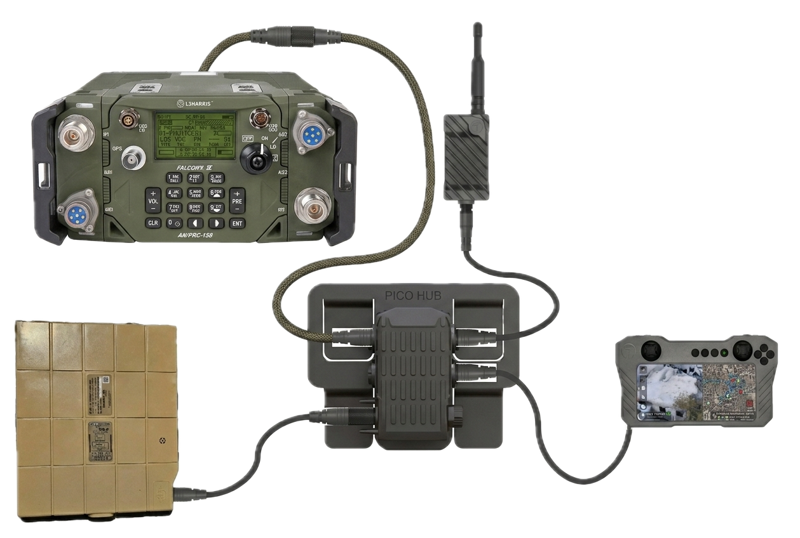
Closed-Loop Targeting Architecture
APPLIED ARTIFICIAL INTELLIGENCE
sUAS Video & Telemetry
→
ATAK UAS Tool
→
Shrike Nano Plugin
→
ATAK COP
→
Digital CFF (VMF)
→
AFATDS
RTSP → image/metadata pairs
AiTR + passive geolocation
Operator designates target
via TSM / MUOS
Fire mission generation
Skydio X10D / PDW C100
This architecture lets the forward observer move directly from aerial reconnaissance to fire mission generation minimizing manual entry and shortening detect-to-fire timelines.
GVSETS
GROUND VEHICLE SYSTEMS ENGINEERING & TECHNOLOGY SYMPOSIUM | 2026
NDIA Michigan Chapter
Notes:
Walk the closed-loop pipeline left to right: aircraft, UAS Tool, Shrike plugin with AiTR and geolocation, COP, operator designation, digital CFF, AFATDS via VMF.

Slide 6
UAS Tool Integration
APPLIED ARTIFICIAL INTELLIGENCE
UAS Tool provides ground control of multiple aircraft platforms. It demultiplexes RTSP video into image–metadata pairs using native ATAK functionality.
OPERATOR WORKFLOW
1
Fly aircraft via UAS Tool plugin to area of interest
By handling new-airframe integration, UAS Tool gives Shrike a platform-agnostic feed to ingest. Shrike picks up pairs from a last-in, first-out (LIFO) queue so the most recent image is always processed.
2
Shift to Shrike plugin to identify and nominate targets
3
UAS Tool keeps running in background; aircraft stays under operator control via ground-control case
GVSETS
GROUND VEHICLE SYSTEMS ENGINEERING & TECHNOLOGY SYMPOSIUM | 2026
NDIA Michigan Chapter
Notes:
Explain the division of labor between UAS Tool (flight/ground control) and Shrike (targeting), and the LIFO queue design.

Slide 7
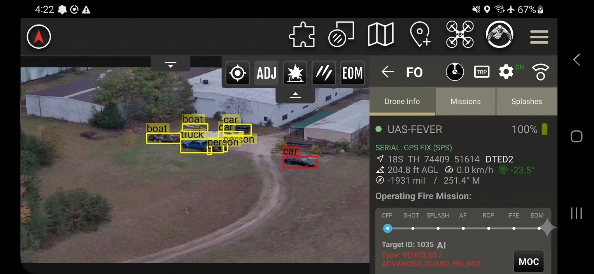
Aided Threat Recognition
APPLIED ARTIFICIAL INTELLIGENCE
AiTR assists operators in identifying potential targets from sUAS video, cutting cognitive load and reaction time. Operators could use it as a cueing aid, not the sole basis for nomination.
WHERE INFERENCE RUNS
FIDELITY vs. CYCLE TIME TRADEOFF
On the operator's end-user device (EUD), using onboard GPU or NPU. Inference is typically the largest contributor to overall system cycle time.
Higher-fidelity models detect more true positives; lower-fidelity models run faster and see more frames per unit time.
On-device AI inference continues to improve, but long-lived fielded mobile hardware creates heterogeneity, and low-bit quantization needs pipelines/data not always available in the field.
GVSETS
GROUND VEHICLE SYSTEMS ENGINEERING & TECHNOLOGY SYMPOSIUM | 2026
NDIA Michigan Chapter
Notes:
Cover aided threat recognition: cueing not sole nomination, and the model fidelity vs cycle time trade-off driven by mobile inference hardware.

Slide 8
Target Tracking & Geolocation
APPLIED ARTIFICIAL INTELLIGENCE
TRACKING
GEOLOCATION
Detections are reported as Cursor on Target (CoT) messages. Associating new detections with prior tracks guards against saturating the COP.
Passive single-camera geolocation updates position each frame, tuned for area-effect weapons with commodity sensors, trading initial accuracy for algorithmic efficiency.
Camera compensation and quadratic scaling with detection count make tracking a major cycle-time driver; Shrike offers multiple algorithms for tracking.
Benchmarked against observer visual estimates. Subsequent relative corrections are prioritized for accuracy; OEM implementation of position/attitude standards is occasionally uneven.
GVSETS
GROUND VEHICLE SYSTEMS ENGINEERING & TECHNOLOGY SYMPOSIUM | 2026
NDIA Michigan Chapter
Notes:
Cover CoT-based tracking, data association across frames, and passive single-camera geolocation optimized for area-effect weapons.

Slide 9
Field Evaluation with 3/101
APPLIED ARTIFICIAL INTELLIGENCE
Shrike Nano was integrated and tested within a Brigade Combat Team from the 101st Airborne Division (Air Assault) during training events at Fort Campbell, Kentucky.
Unit
3rd BCT, 101st Airborne Division (Air Assault)
Location
Fort Campbell, Kentucky
Events
Training exercises + CALFEX
Platform
Reconnaissance flights with the PDW C100
GVSETS
GROUND VEHICLE SYSTEMS ENGINEERING & TECHNOLOGY SYMPOSIUM | 2026
NDIA Michigan Chapter
Notes:
Introduce the operational evaluation: integration with 3rd BCT, 101st Airborne at Fort Campbell, culminating in brigade-level CALFEX with the PDW C100.

Slide 10
Geolocation Accuracy Results
APPLIED ARTIFICIAL INTELLIGENCE
Target location error (TLE) measured during reconnaissance flights with the PDW C100, at increasing range from the target:
Range <115 m
Range <350 m
Range <650 m
6 m
8 m
24 m
Target Location Error
Target Location Error
Target Location Error
Results validate the baseline capability of the passive geolocation algorithm, while highlighting the need for improved sensor metadata standardization and calibration across aircraft platforms.
GVSETS
GROUND VEHICLE SYSTEMS ENGINEERING & TECHNOLOGY SYMPOSIUM | 2026
NDIA Michigan Chapter
Notes:
Present the geolocation accuracy data: TLE grows with range, validating baseline capability while showing the need for metadata standardization.

Slide 11
Field Observations
APPLIED ARTIFICIAL INTELLIGENCE
WHAT WORKED
FRICTION POINTS
During CALFEX, Shrike Nano generated target coordinates and transmitted digital fire missions through AFATDS and MFCS.
UAS range limitations, RF interference, aircraft firmware variability, and instability in some TAK software components.
Operators reported that generating target grids directly from aerial recon significantly reduced the cognitive workload of manual target development.
These occasionally required operators to revert to voice communications or adjust procedures but never prevented mission execution.
GVSETS
GROUND VEHICLE SYSTEMS ENGINEERING & TECHNOLOGY SYMPOSIUM | 2026
NDIA Michigan Chapter
Notes:
Cover the CALFEX success and the operational friction points: RF/range/firmware/software, and the strong operator confidence despite them.

Slide 12
Lessons Learned
APPLIED ARTIFICIAL INTELLIGENCE
1
Systems engineering vs, software deployment
2
Metadata consistency is critical
Failures anywhere across UAS, TAK, radios, or fires systems can interrupt the targeting workflow.
KLV formatting and calibration variance across aircraft introduces geolocation inconsistencies.
3
Training methodology matters
4
Network architecture is a key constraint
Classroom instruction immediately followed by hands-on flight ops built proficiency fastest.
Digital fires exposes weaknesses in comms architectures. Close coordination with S-6 is of paramount importance.
GVSETS
GROUND VEHICLE SYSTEMS ENGINEERING & TECHNOLOGY SYMPOSIUM | 2026
NDIA Michigan Chapter
Notes:
Walk through all four lessons: systems engineering framing, metadata consistency, training methodology, and network architecture constraints.

Slide 13
Conclusions
APPLIED ARTIFICIAL INTELLIGENCE
Field experience shows Shrike Nano meets operational requirements for target detection, geolocation, and tracking within the constraints of existing indirect fires networks.
DECISION SUPPORT
NETWORK PLANNING
A CASE STUDY
AI-enabled digital fires, UAS feeds, and interoperable ATAK standards augment decisions in time-sensitive scenarios.
Robust IP transport is a precondition for success — a shared challenge across systems, not unique to Shrike Nano.
For AI-enabled TTPs that are faster, more responsive, and more lethal — while prioritizing warfighter survivability.
GVSETS
GROUND VEHICLE SYSTEMS ENGINEERING & TECHNOLOGY SYMPOSIUM | 2026
NDIA Michigan Chapter
Notes:
Close with the case-study framing: Shrike Nano meets requirements, network planning is the precondition, and the broader mission is faster, more lethal, safer TTPs.

